Slide 1

B + Tree with bloom filter
Analysis and Implementation of Hybrid Data Structure

Slide 2
TEAM ERROR 404
TEAM MEMBERS:
CB.EN.U4CSE21407-ASHVABA
CB.EN.U4CSE21417-ELA ANANYA
CB.EN.U4CSE21429-KARTHIK
CB.EN.U4CSE21452-SAKTHI B
CB.EN.U4CSE21457-SIVARAJKUMAR

Slide 3

HYBRID DATA STRUCTURE
It is a data structure that combines the features of two or more different data structures. Hybrid data structures are often used to improve the performance or efficiency of a particular data structure.
Reasons why we prefer hybrid data structure:
Improved performance
Increased flexibility
Reduced complexity

Slide 4

B+ Tree
B+ tree is a specialized form of a Binary tree that is used to store sorted data in a way that allows for efficient searching, insertion, and deletion.
B+ trees are made up of a series of nodes
The keys in a B+ tree are sorted in ascending order.
The root node of a B+ tree can contain fewer than m keys, but all other nodes must contain at least m/2 keys..

Slide 5
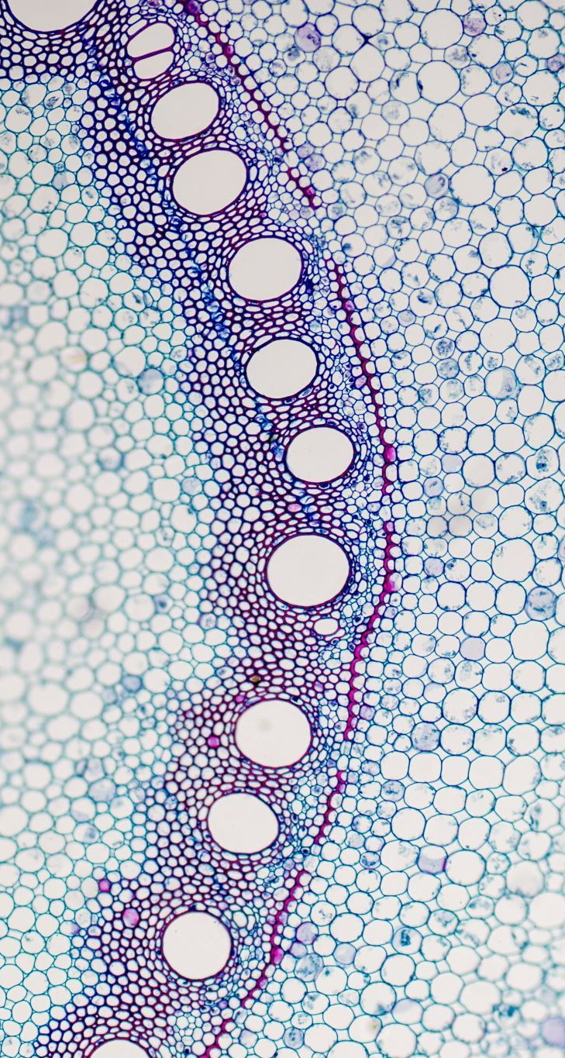
Operations performed in the B+ tree
Searching an element:
When searching for a key in a B+ tree, the search starts at the root node and proceeds down the tree until the desired key is found.
Insertion:
When inserting a new key into a B+ tree, the key is first inserted into the leaf node that contains the key's range.
Deletion:
When deleting a key from a B+ tree, the key is first deleted from the leaf node that contains the key.

Slide 6

Advantages of using B+ tree
Efficient searching: B+ trees allow for efficient searching, with a worst-case time complexity of O(log n), where n is the number of keys in the tree.
Efficient insertion and deletion: B+ trees allow for efficient insertion and deletion, with a worst-case time complexity of O(log n).
Scalability: B+ trees are scalable, meaning that they can be used to store large amounts of data without becoming too slow or complex.
Space efficiency: B+ trees are space-efficient, meaning that they use less space than other data structures such as balanced binary search trees.

Slide 7

Insertion in B+ tree
For Example, lets us take 5,20,22,38,52
At first, the binary + tree will be empty []
Order (m) – 3
Maximum keys (m-1) - 2

Slide 8
While inserting 22, it becomes overflow
This is the root node
5
20
22
38
50
These are the leaf nodes

Slide 9

Searching in B+ tree
In the inserted B+ tree, we are going to search the element 50.

Slide 10
Search key =60
22
5
20
38
50

Slide 11
The element is greater than root node, so it goes to the right
Searching from root node
22
5
20
38
50

Slide 12
Searching from right leaf nodes
22
5
20
38
50

Slide 13
22
5
20
38
50
ELEMENT FOUND

Slide 14

Deletion in B+ tree
We have inserted 5,20,22,38,50 in the B+ tree
We have to delete 20 element from the B+ tree.

Slide 15
Deleting element 40
22
5
20
38
50

Slide 16

Bloom Filter
•A Bloom filter is a space-efficient probabilistic data structure that is used to test whether an element is a member of a set.
•False positive matches are possible, but false negatives are not – in other words, a query returns either "possibly in set" or "definitely not in set".
• Elements can be added to the set, but not removed (though this can be addressed with the counting Bloom filter variant) the more items added, the larger the probability of false positives.

Slide 17

Some advantages of using Bloom filter
Check if a username is already in use: When a user registers for a website, the website can use a Bloom filter to check if the username is already in use.
Check if an email address is already subscribed: When a user subscribes to a newsletter, the website can use a Bloom filter to check if the email address is already subscribed.
Filter out spam: Spam filters often use Bloom filters to quickly identify emails that are likely to be spam. If an email's contents match the Bloom filter, the email is more likely to be spam.

Slide 18
Insert ‘9’
Empty Array
Insert ‘11’
1
1
0
1
0
0
0
0
0
1
2
3
4

Slide 19

Overview of B+ tree with Bloom Filter
The hybrid data structure which we have to work on is B+ tree with bloom filter.
A B+ tree is a balanced tree data structures and a Bloom filter is a probabilistic data structure.
By combining these two structures, the hybrid data structure gains several advantages:
•Improved Search Performance
•Reduced Disk I/O
•Space Efficiency
•Scalability

Slide 20

Insertion in B+ tree with Bloom Filter
For Example, lets us take 10,20,30,40,50
At first, the binary + tree will be empty []
Order (m) – 3
Maximum keys (m-1) – 2

Slide 21
10
- Bloom filter might impact the storage or search efficiency in a B+ tree but it does not directly affect the insertion of the B+ tree with bloom filter.
- If n=5, we are taking 10,20,30,40,50 as input(x).
- Hash function is x mod 5.
20
30
40
50
0
1
2
3
4
10 mod 5 = 0
 | 0 | 0 | 0 | 0
20 mod 5 =0
30 mod 5 =0
40 mod 5 =0
50 mod 5 =0
It gets over ridded on the same index

Slide 22
While inserting 30, it becomes overflow
This is the root node
10
20
30
40
50
These are the leaf nodes

Slide 23

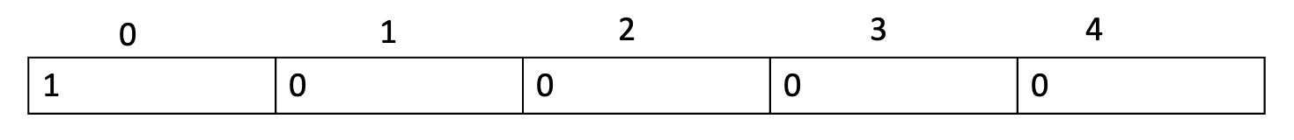
Searching in B+ tree with bloom filter
In the inserted B+ tree, we are going to search the element 30 and 60.
30 mod 5 = 0
So, it is false positive. It might be there or not be there, so we are finding by searching method.
60 mod 5 = 0
It is false positive. It might be there or not be there, so we are finding by searching method.

Slide 24
Search key =30
30
10
20
40
50

Slide 25
Searching from root node
30
10
20
40
50

Slide 26
30
The Search key is same as the root node
10
20
40
50
RETURNS TRUE

Slide 27
Search key =60
30
10
20
40
50

Slide 28
The element is greater than root node, so it goes to the right
Searching from root node
30
10
20
40
50

Slide 29
Searching from right leaf nodes
30
10
20
40
50

Slide 30
30
10
20
40
50
RETURNS FALSE

Slide 31

Deletion in B+ tree using Bloom Filter
We have inserted 10,20,30,40,50 and now we are going to delete 40 element from the B+ tree using bloom filter
40 mod 5 = 0
It is false-positive so it might be present in the tree or not.
We have to search and if found, delete it.
0
1
2
3
4
1 | 0 | 0 | 0 | 0

Slide 32
Deleting element 40
30
10
20
40
50

Slide 33

Application Of this hybrid data structure
Web caching: B+ trees can be used to store web pages in a cache
File systems: B+ trees can be used to store files in a file system.
Email servers: B+ trees can be used to store email messages in an email server.
Distributed Systems: In distributed systems, the hybrid structure can be utilized to optimize network communication and reduce latency

Slide 34

Performance Analysis
Operation - Time complexity
Insertion - O(log n)
Searching - O(log n)
Deletion - O(log n)
Time complexity: The time complexity of a B+ tree with Bloom filter depends on the operations being performed.
The time complexity of the insert, search, and delete operations is O(log n) because the B+ tree is a balanced tree

Slide 35

Continuation…
Space complexity;
The space complexity of the Bloom filter is O(k), where k is the number of bits in the Bloom filter. This is because each bit in the Bloom filter must be stored.
The total space complexity of the B+ tree with Bloom filter is O(n + k).
Performance:
The performance of the hybrid data structure is better than the performance of either the Bloom filter or the B+ tree alone..

Slide 36

EXPERIMENTAL EVALUATION
The following datasets were used in the experiments:
Random numbers: A dataset of 100,000 random numbers was generated.
Sequential numbers: A dataset of 100,000 sequential numbers was generated.
Sorted numbers: A dataset of 100,000 sorted numbers was generated
The following specific considerations were taken into accounts for the experiments:
The number of keys in the dataset was varied from 10,000 to 1,000,000.
The number of hash functions used by the Bloom filter was varied from 1 to
The tree order of the B+ tree was varied from 2 to 8.

Slide 37

Results of the analysis
Dataset | Number of keys | Time to insert (ms) | Time to search (ms)
Random numbers | 10,000 | 1.0 | 0.1
Random numbers | 100,000 | 10.0 | 1.0
Random numbers | 1,000,000 | 100.0 | 10.0
Sequential numbers | 10,000 | 0.5 | 0.05
Sequential numbers | 100,000 | 5.0 | 0.5
Sequential numbers | 1,000,000 | 50.0 | 5.0
Sorted numbers | 10,000 | 0.1 | 0.01
Sorted numbers | 100,000 | 1.0 | 0.1
Sorted numbers | 1,000,000 | 10.0 | 1.0

Slide 38

DISCUSSION
Limitations and Challenges:
• False positives
• Limited capacity
• Dynamic operations
Potential Future Improvements:
• Dynamic resizing
• Efficient updates
• Load balancing
• Tuning parameters

Slide 39

Conclusion
This provides as a efficient method to solve problems
The key learnings of this report are:
Importance of hybrid data structures
The understanding of how B+ tree data structure and bloom filter data structure individually and their efficiency when combined together.
Practical efficiency of hybrid data structure
The performance analysis of these hybrid data structures

Slide 40

THANK YOU

